Slide 1
Reece Doyle
T1A2 – Portfolio Website

Slide 2
Sitemap

Slide 3


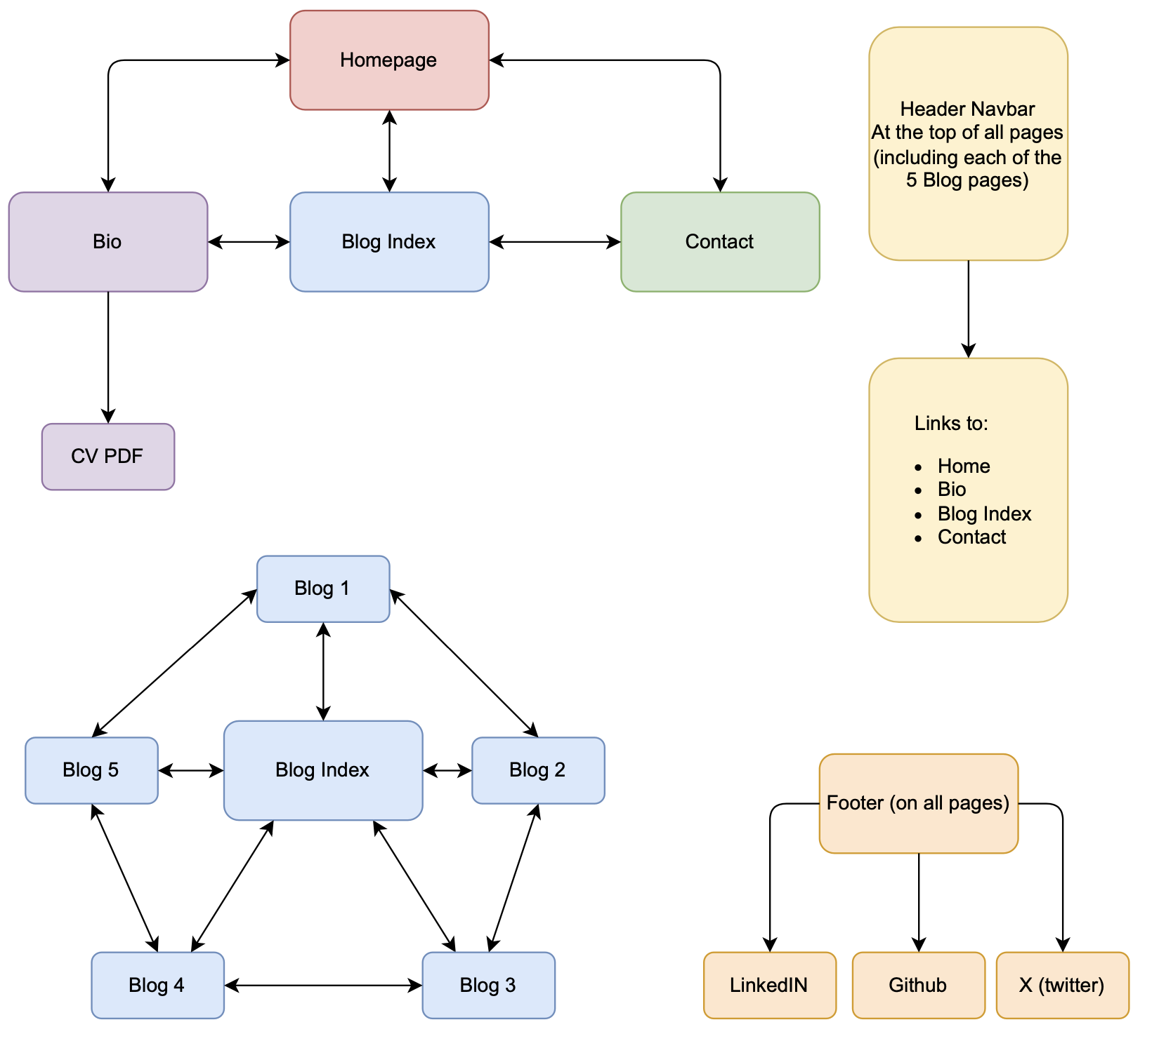



Sitemap

Slide 4
Sitemap
Four Main Pages
Homepage
Bio Page (with link to CV PDF)
Blog Index
Contact

Slide 5
Sitemap
Four Main Pages
Homepage
Bio Page (with link to CV PDF)
Blog Index
Contact
Blog Index Page
Access to all 5 Blogpost pages
‘Next’ & ‘Previous’ nav buttons
Link back to Blog Index

Slide 6
Sitemap
Four Main Pages
Homepage
Bio Page (with link to CV PDF)
Blog Index
Contact
Header
Logo as link to homepage
Button links:
Bio
Blog
Contact
At the top of all pages
Blog Index Page
Access to all 5 Blogpost pages
‘Next’ & ‘Previous’ nav buttons
Link back to Blog Index

Slide 7
Sitemap
Four Main Pages
Homepage
Bio Page (with link to CV PDF)
Blog Index
Contact
Header
Logo as link to homepage
Button links:
Bio
Blog
Contact
At the top of all pages
Blog Index Page
Access to all 5 Blogpost pages
‘Next’ & ‘Previous’ nav buttons
Link back to Blog Index
Footer
Links to my:
LinkedIn
GitHub
X (twitter)
At the bottom of all pages

Slide 8
Wireframes

Slide 9
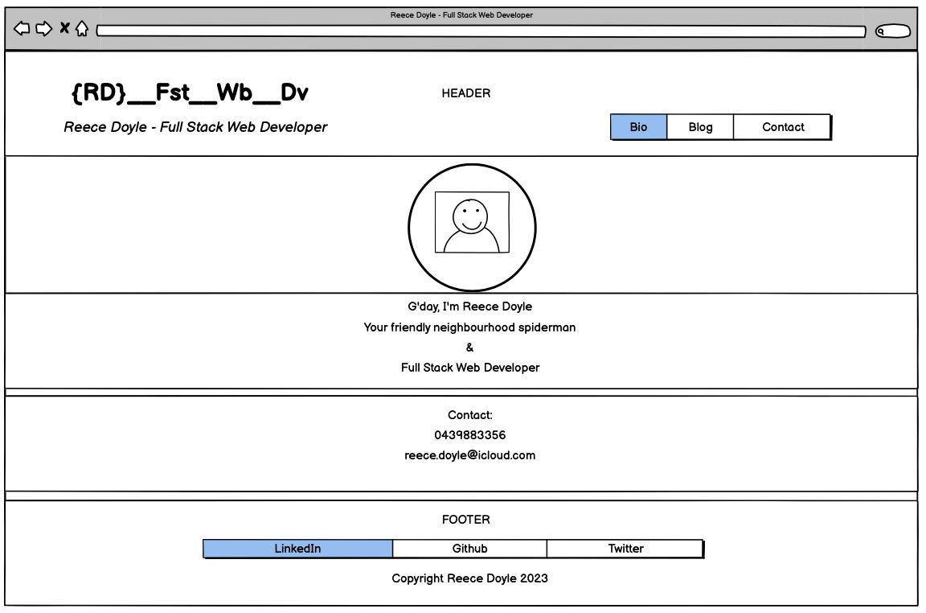
Homepage - Desktop

Slide 10
Homepage - Desktop
Header
Logo featuring link to Homepage
Navbar
Link to all other pages
Picture
Circular portrait
Contact Section
Phone Number and email
Greeting
Welcome text stating who I am and what I do
Footer
Links to socials and copyright

Slide 11
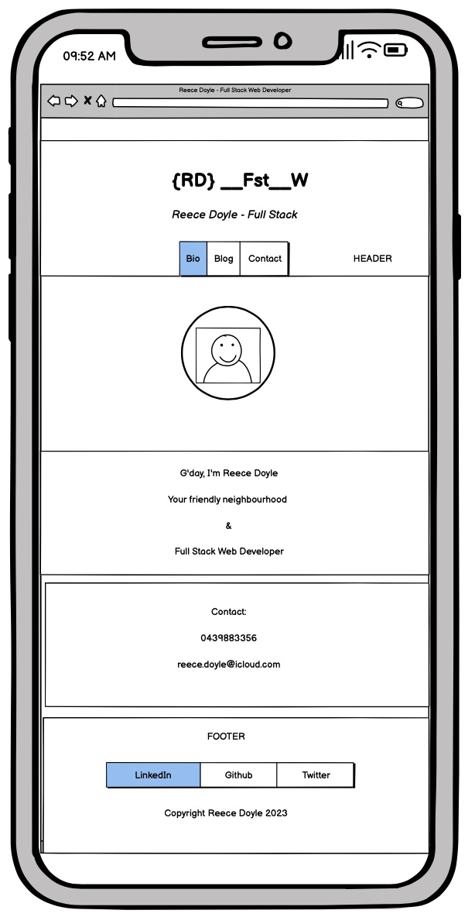
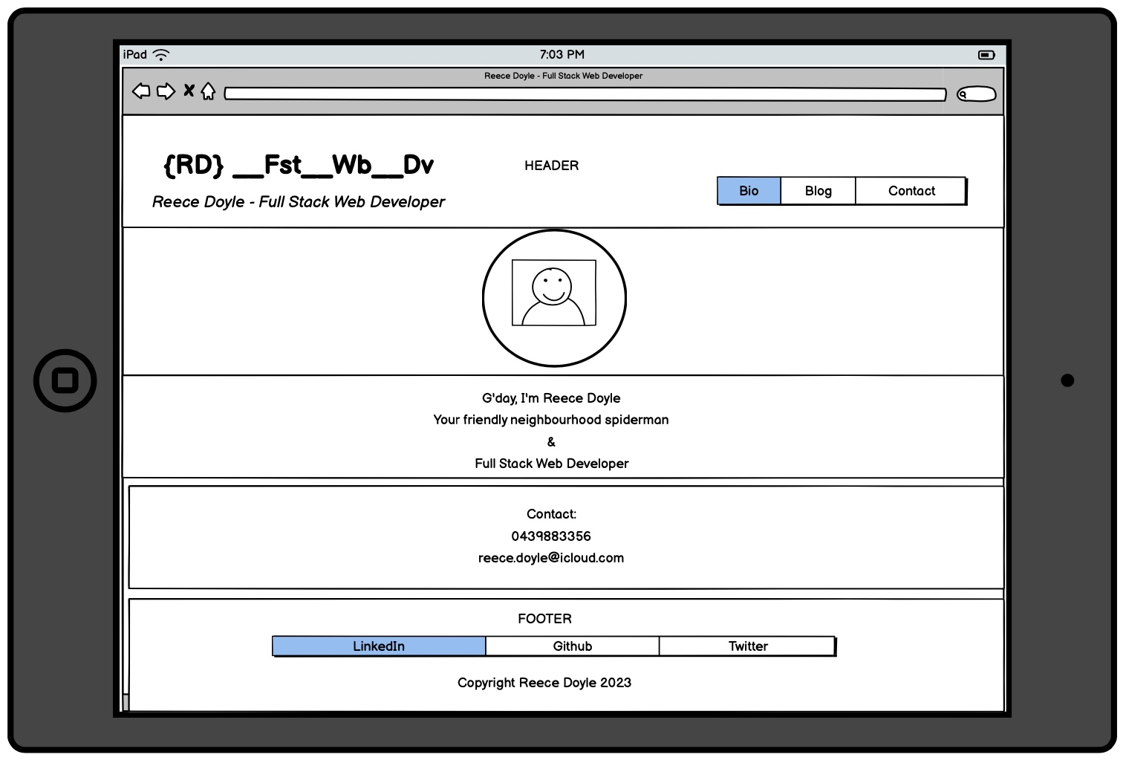
Homepage – Tablet and Phone

Slide 12
Homepage – Tablet and Phone
Phone 600px Max
Turned Header to Centre aligned Column with Flexbox
Reduced size of picture from 300px to 180px
Greeting and Contact Text from 2rem to 1.2rem
Footer required only Margin left and right: auto
Tablet
Flexbox everywhere!
Nothing to change

Slide 13
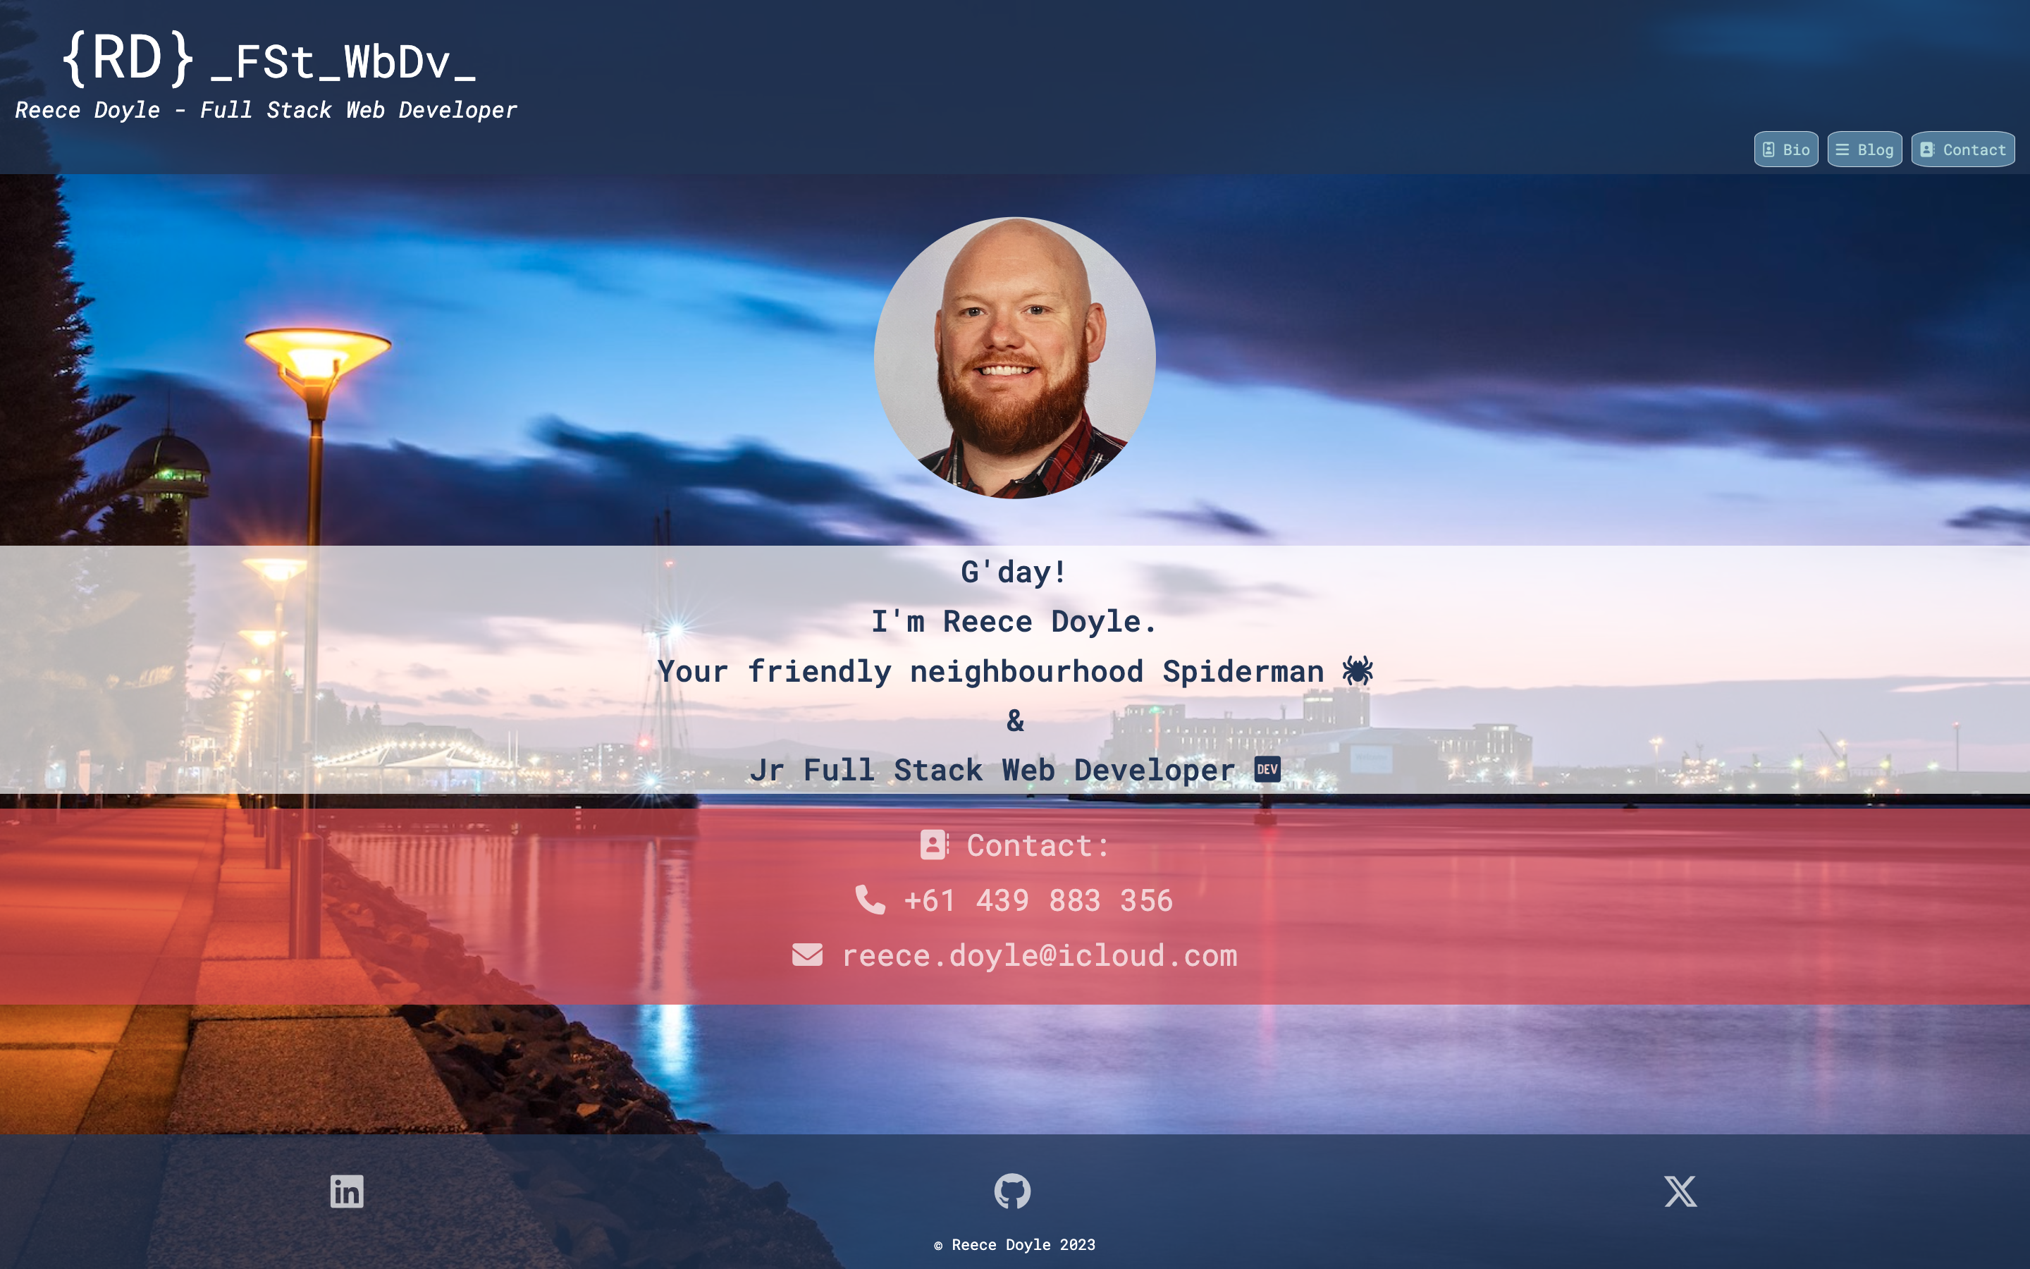
Homepage - Desktop

Slide 14
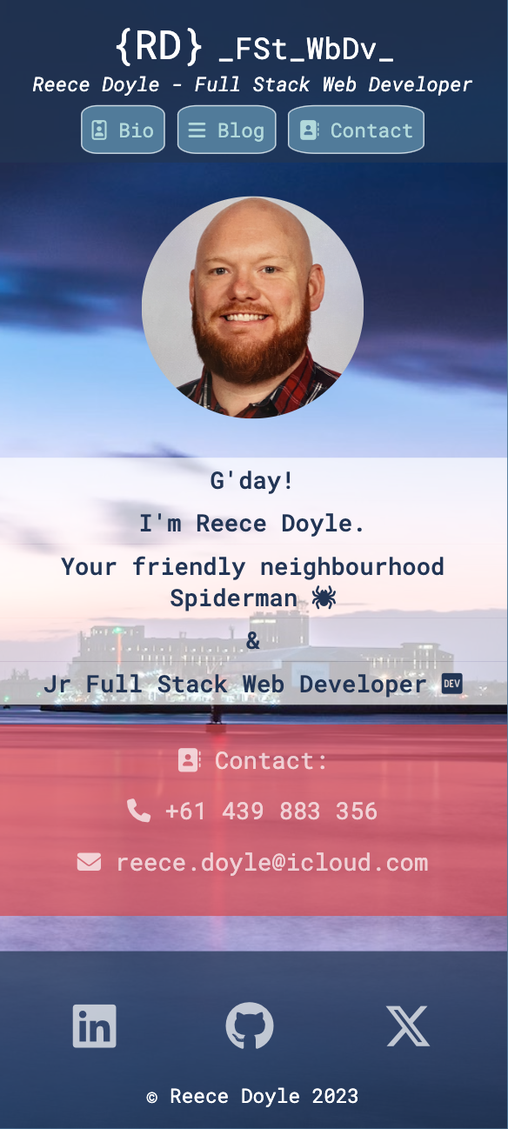
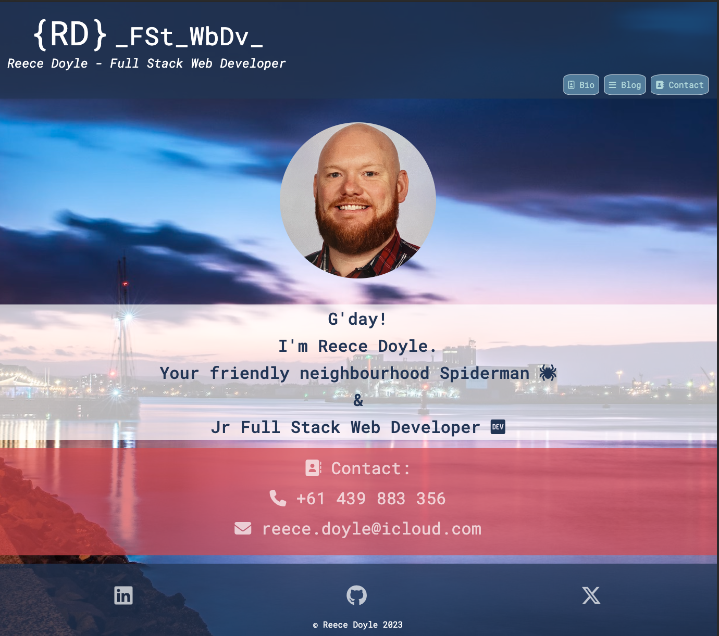
Homepage – Tablet and Phone

Slide 15
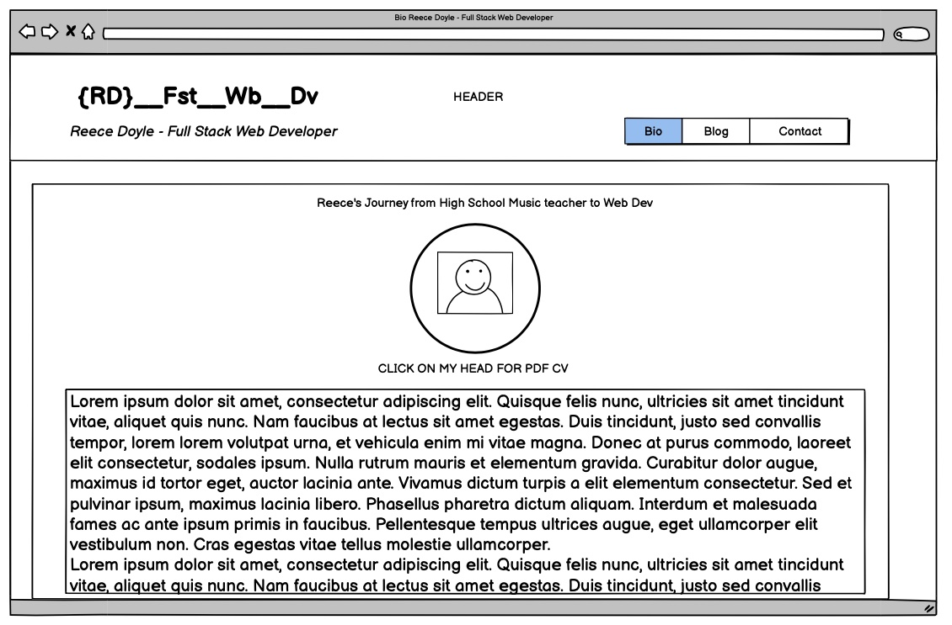
Bio - Desktop

Slide 16
Bio - Desktop
Bio Page
Different circular portrait is also a link to the PDF version of my CV
Bio section
Written by ChatGPT
Lots of UL and OL, <h> and <p>

Slide 17
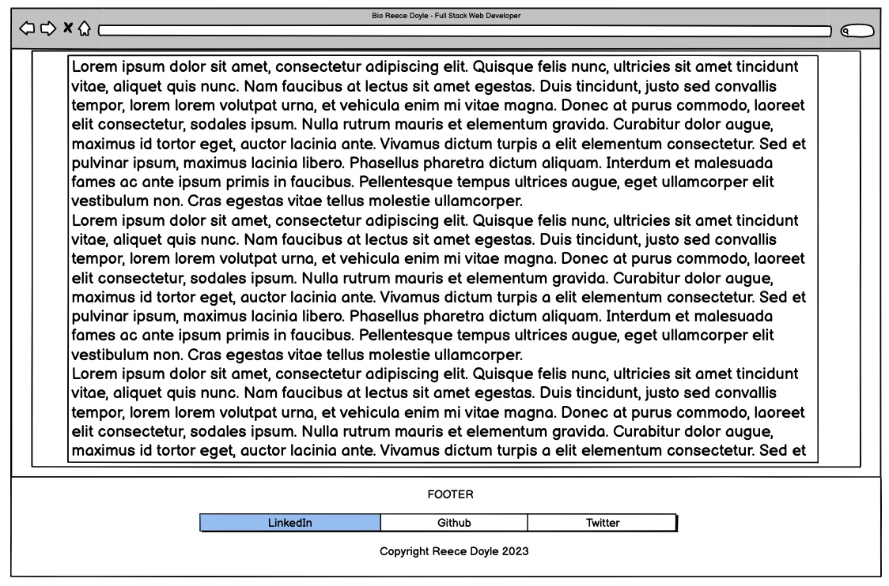
Article Section
Transparent background
Small margin to allow background picture to be seen
Bio - Desktop
Footer
Visible only at full scroll

Slide 18
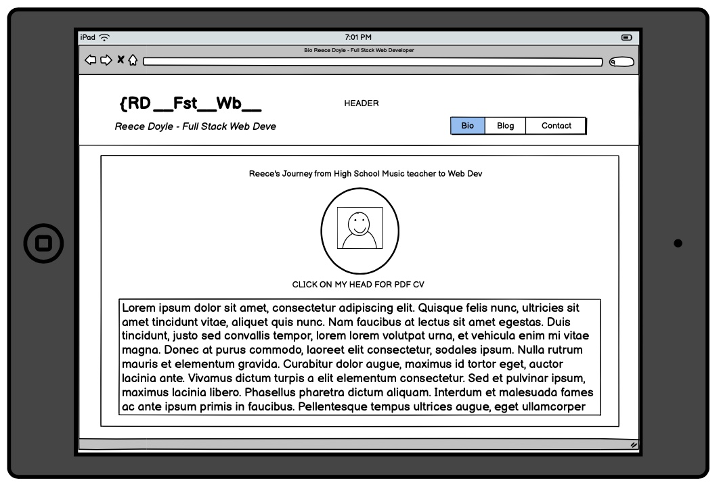
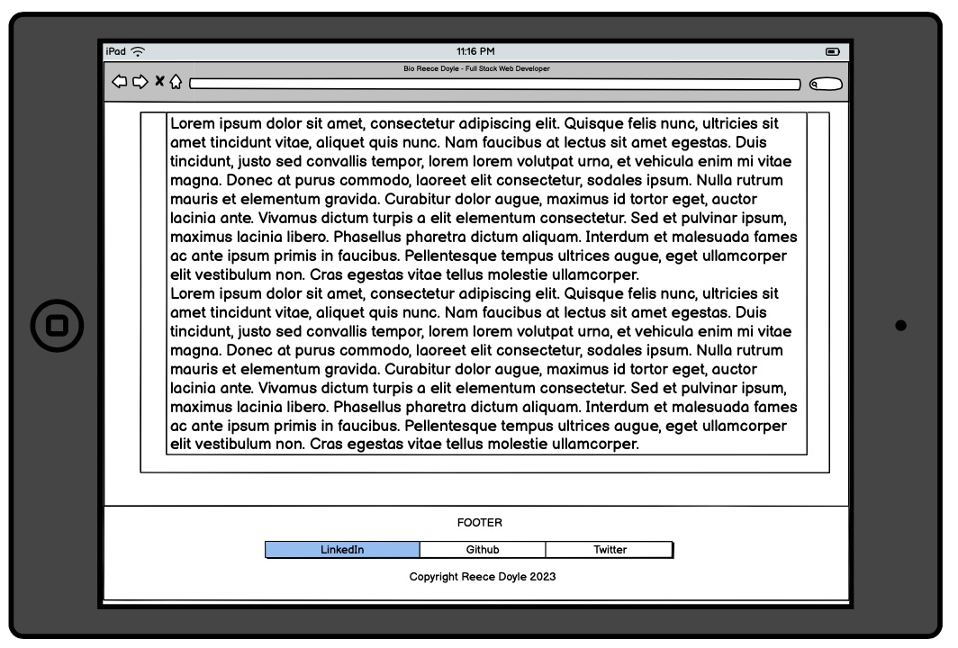
Bio - Tablet
Looked the same as Desktop without any breakpoints!!! Woo!

Slide 19
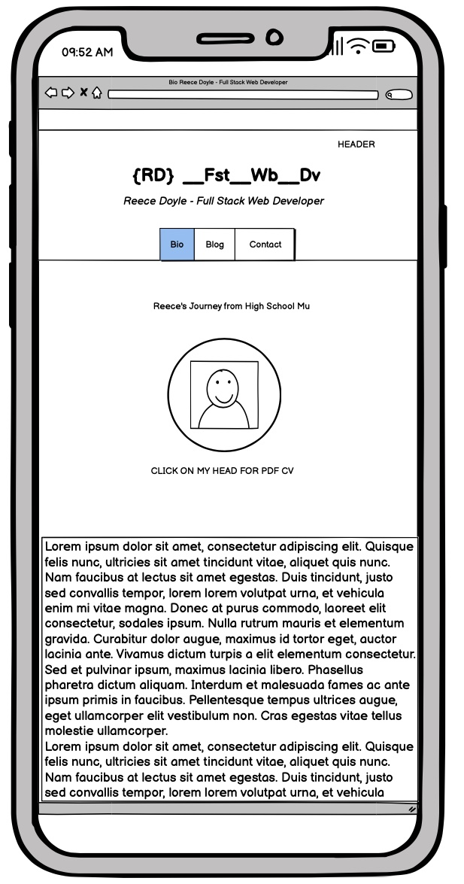
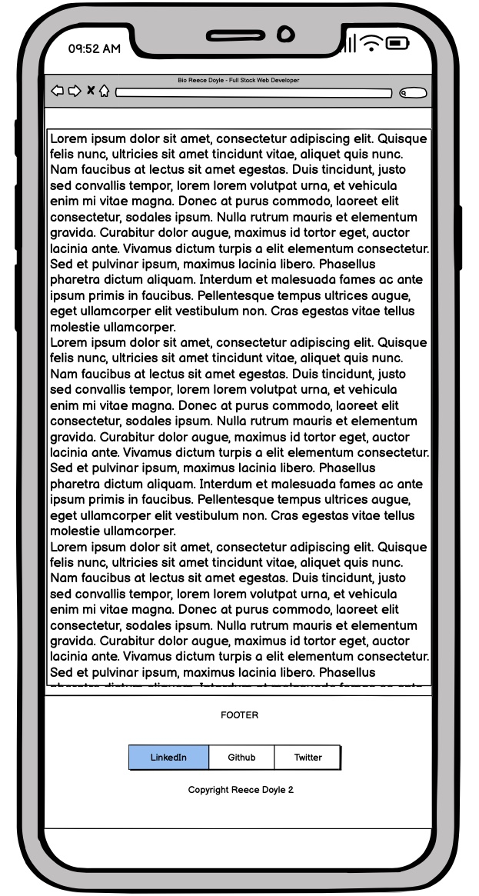
Bio - Phone
Article section
Removed Margin to maximise space
Portrait from 300px to 180px
Font-size for figcaption from 1.6rem to 1rem
Footer
Visible only at full scroll

Slide 20
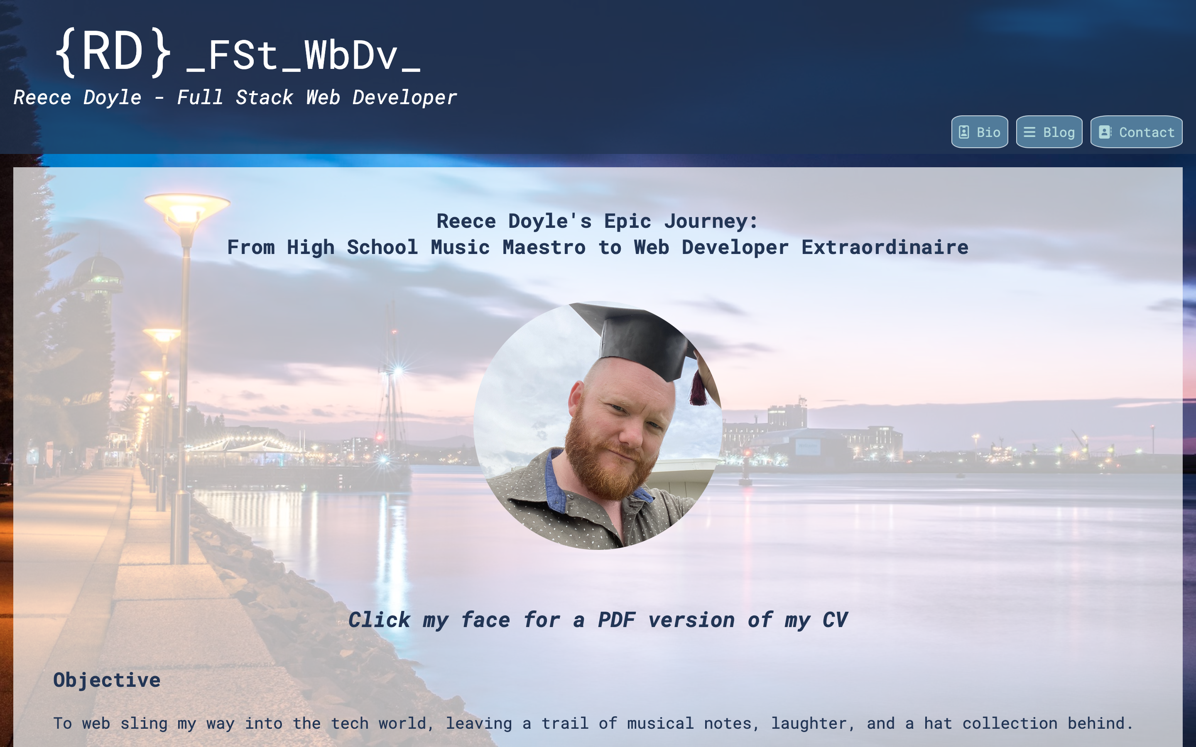
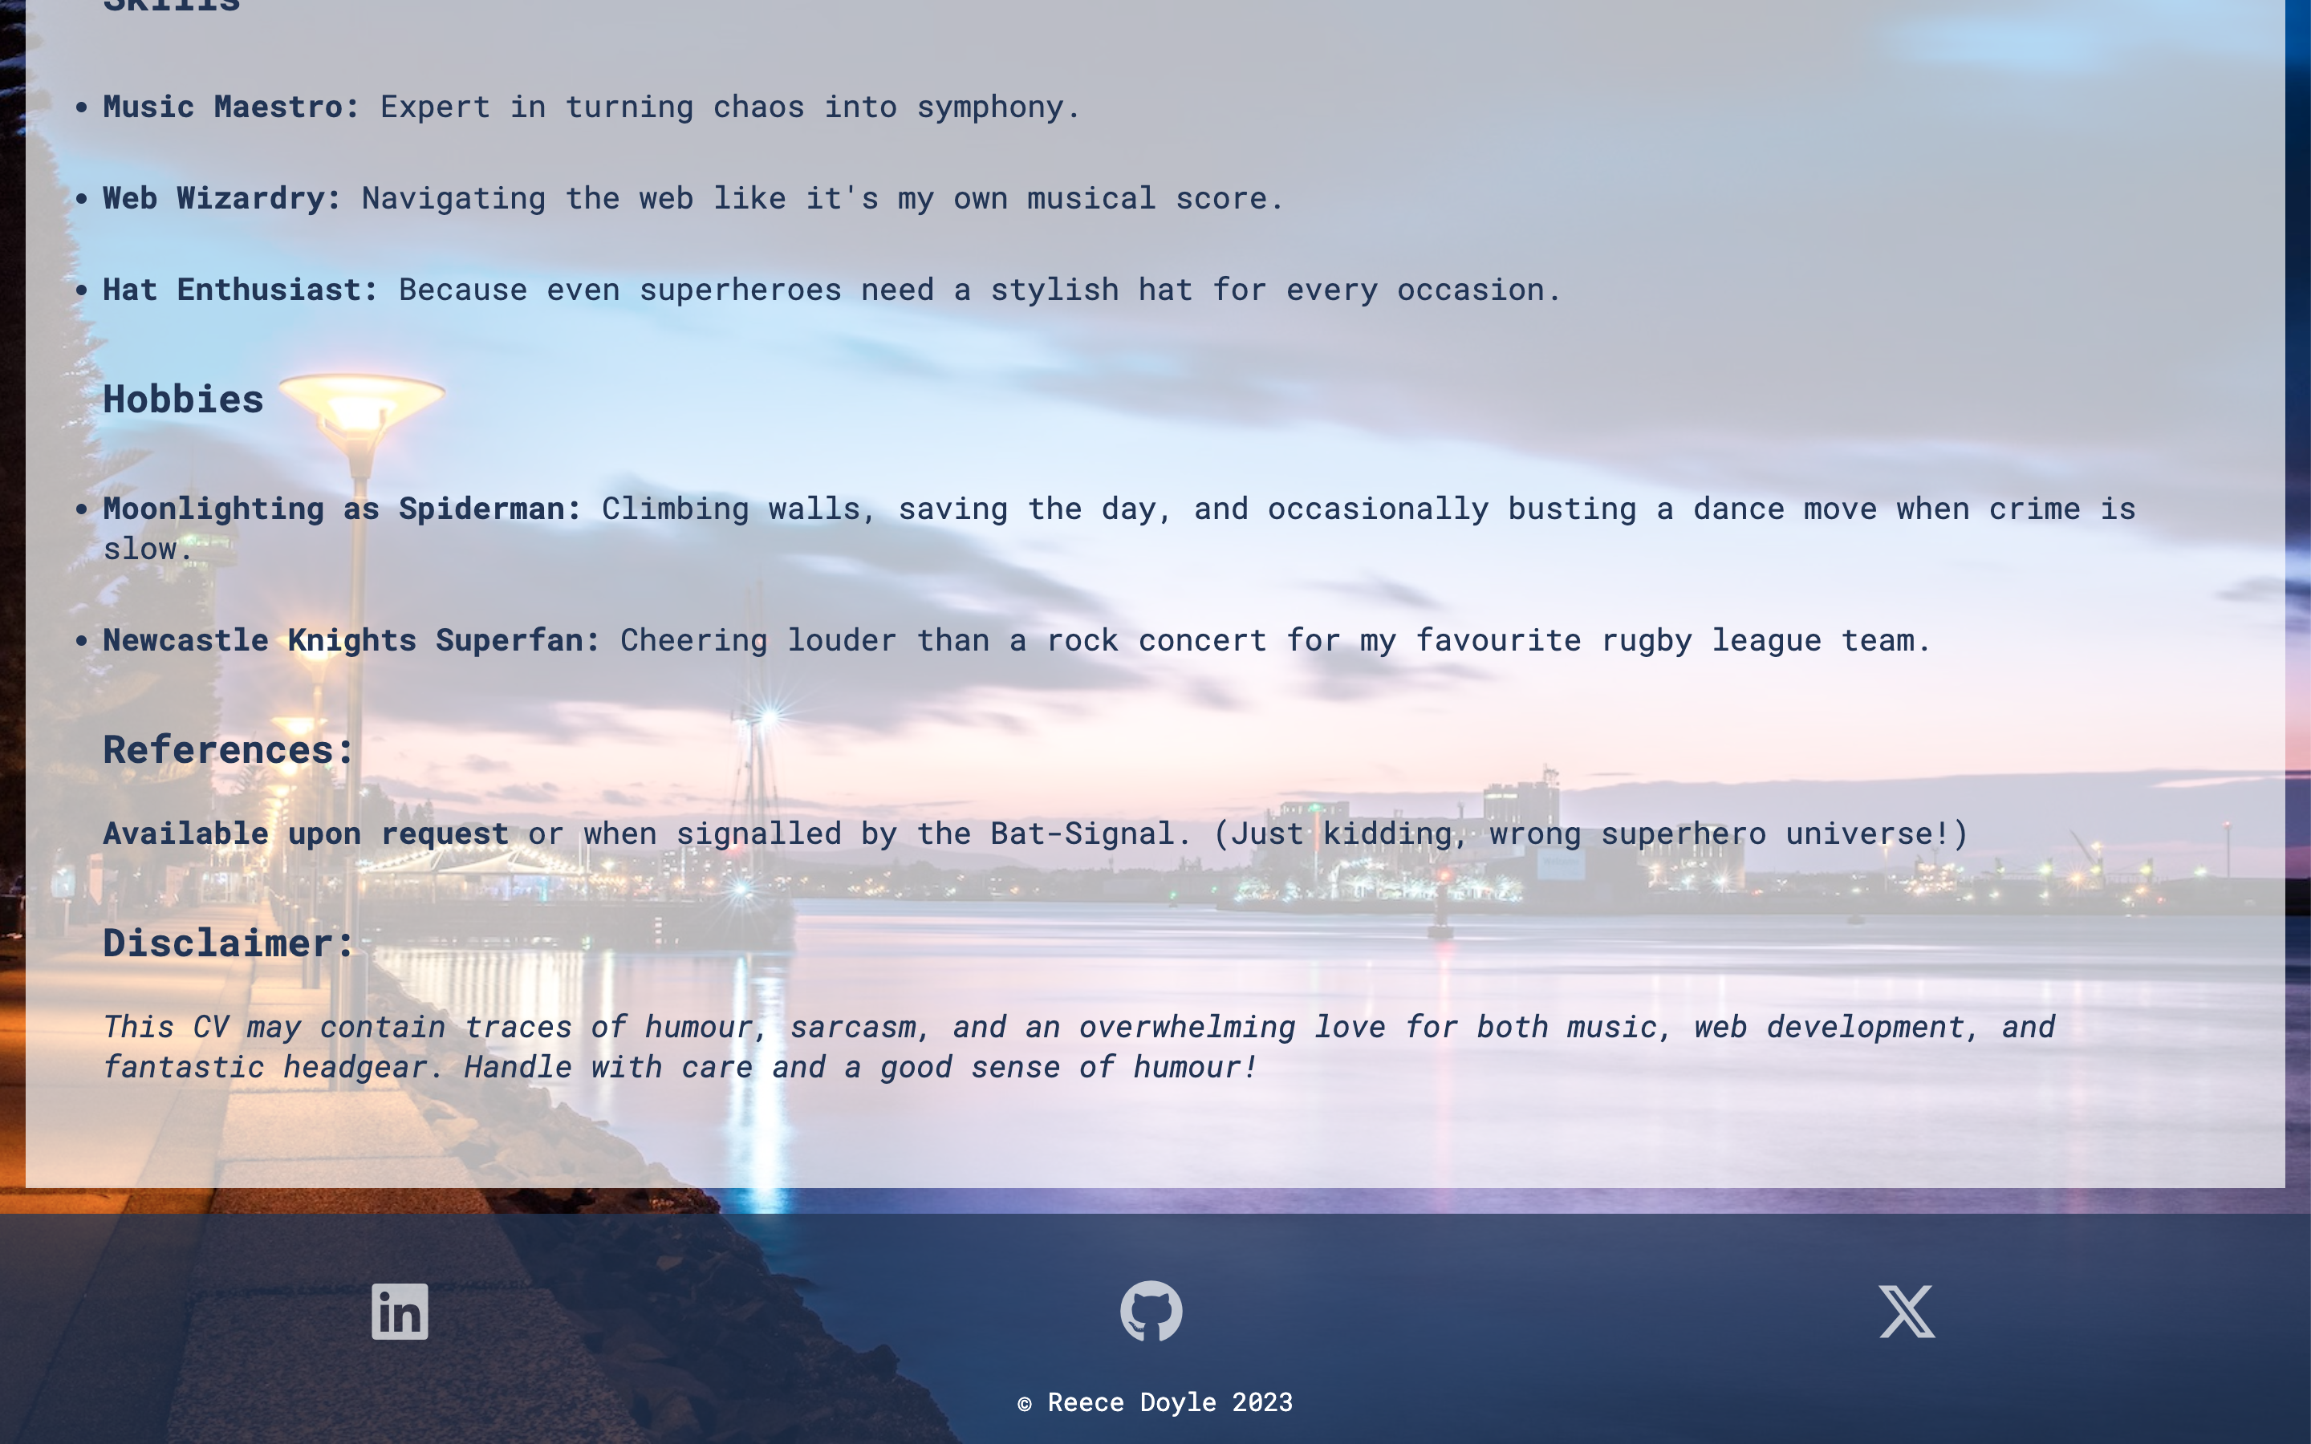
Bio - Desktop

Slide 21
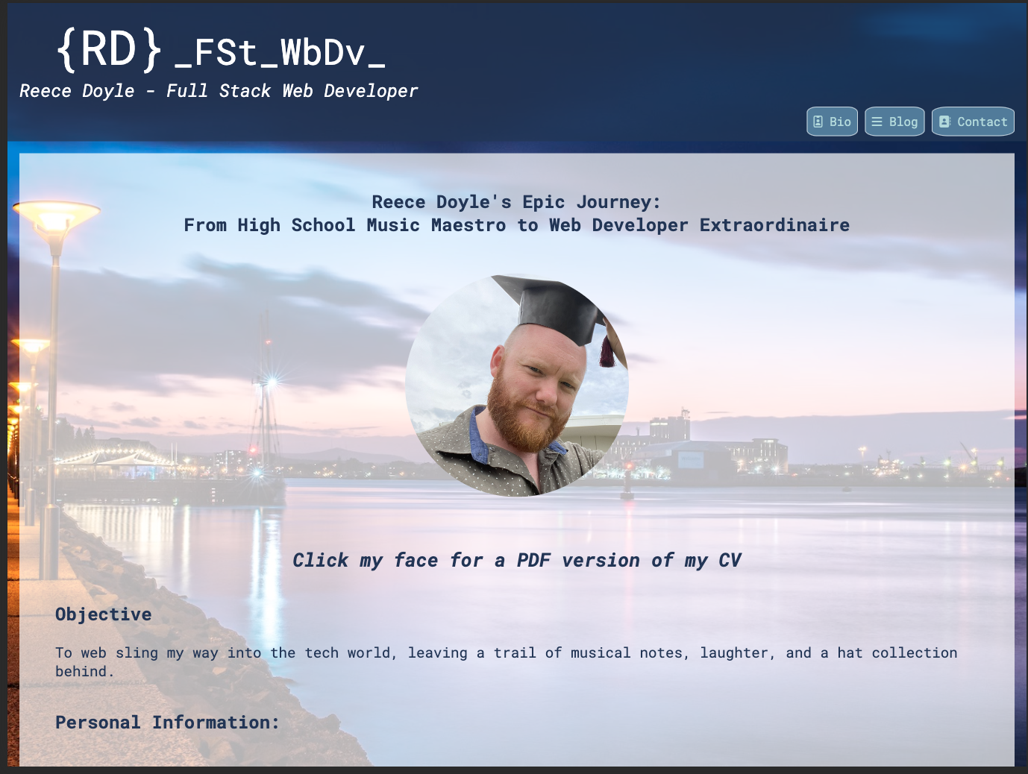
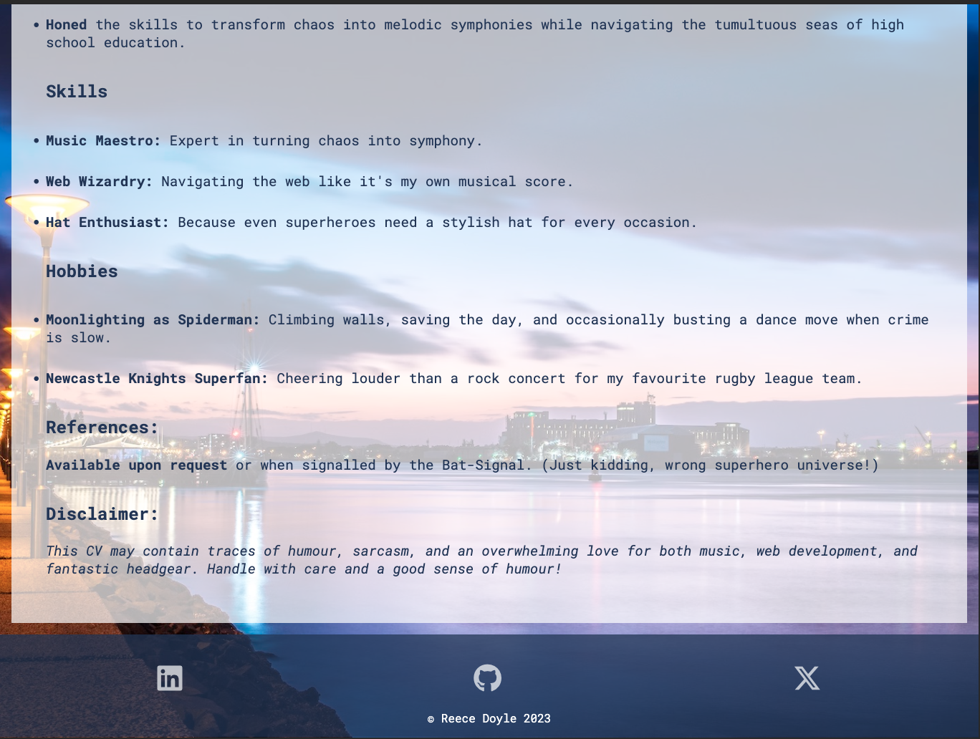
Bio - Tablet

Slide 22
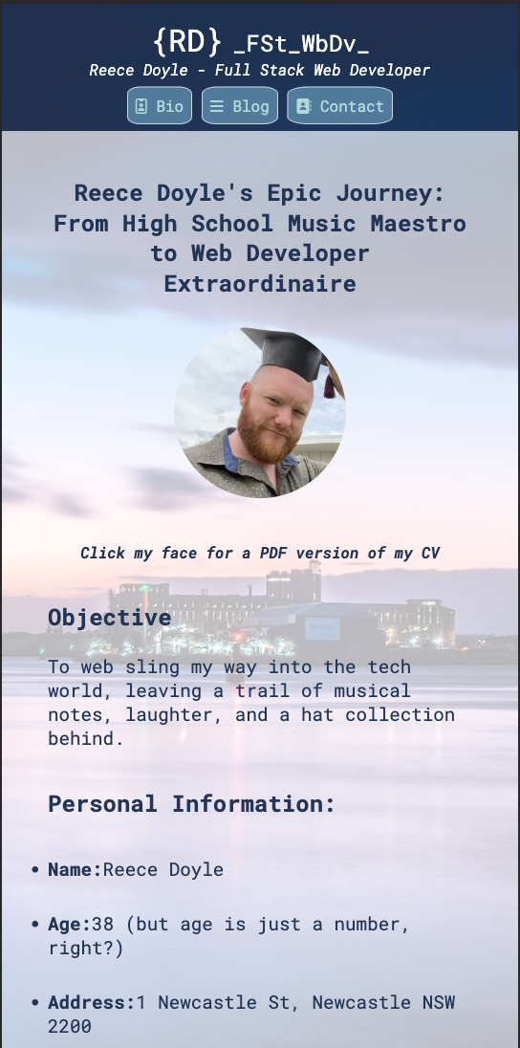
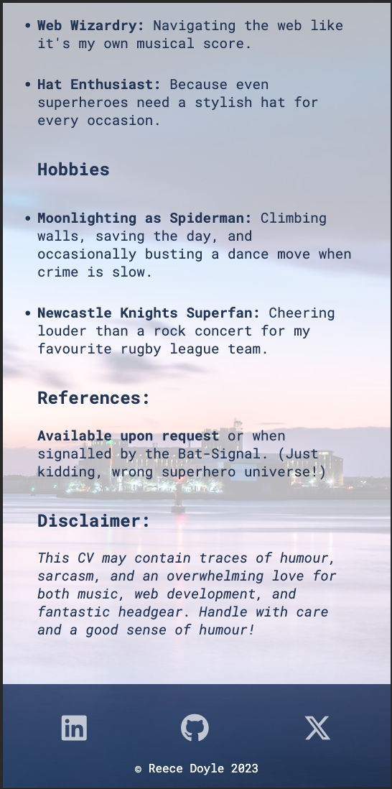
Bio - Phone

Slide 23
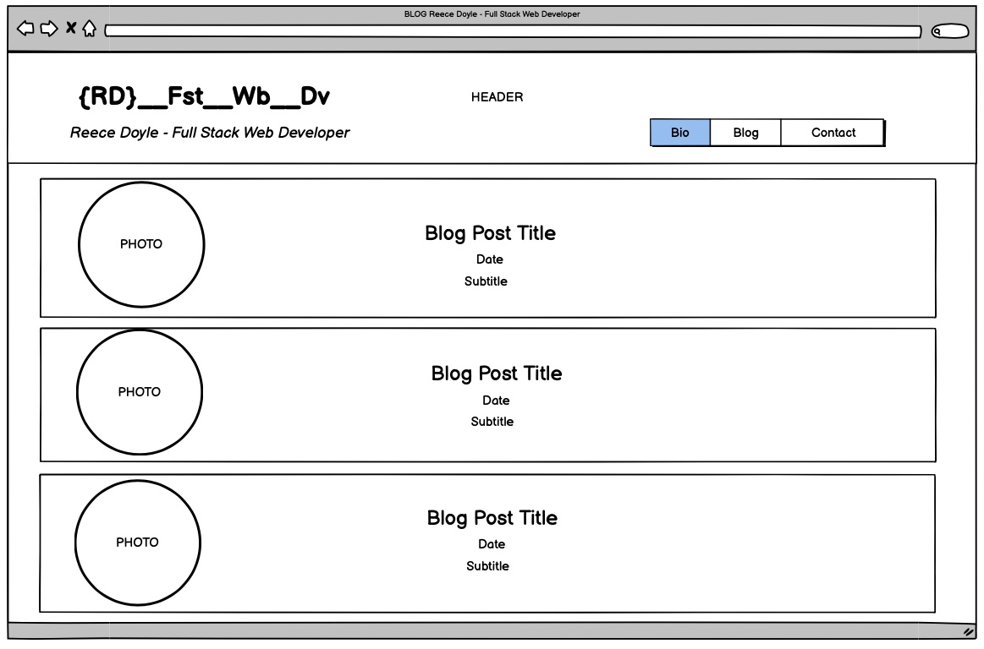
Blog - Desktop
Article sections
All links
Round pictures, date, and subtitle
Margin and padding

Slide 24
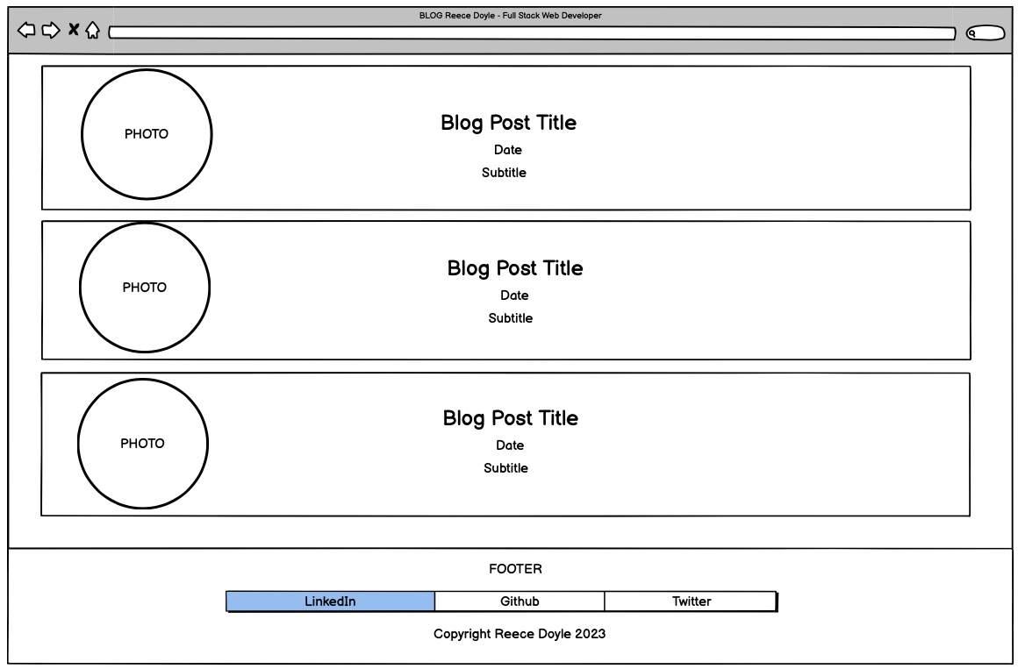
Blog - Desktop
Footer
Visible only at full scroll

Slide 25
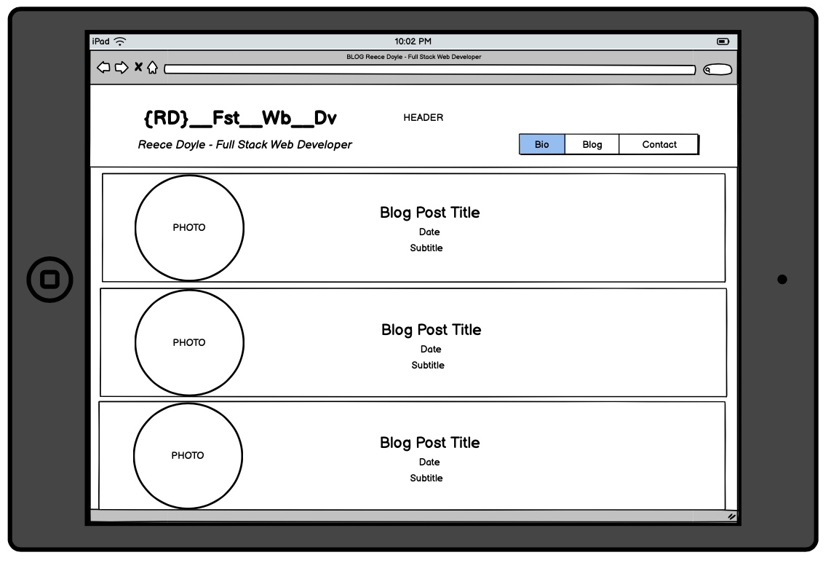
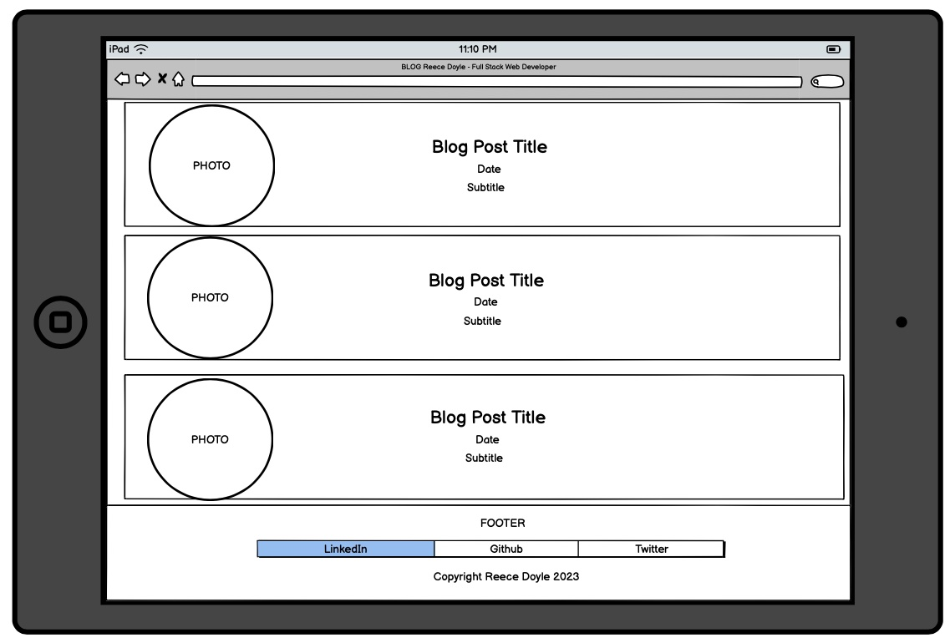
Blog - Tablet
Looked the same as Desktop without any breakpoints!!! Woo!

Slide 26
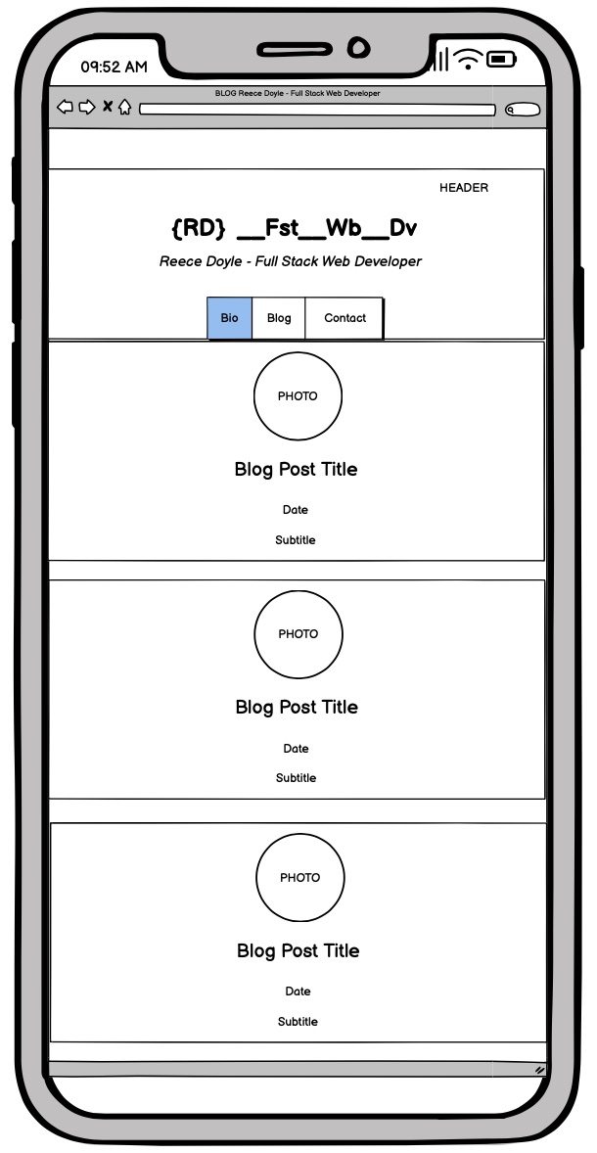
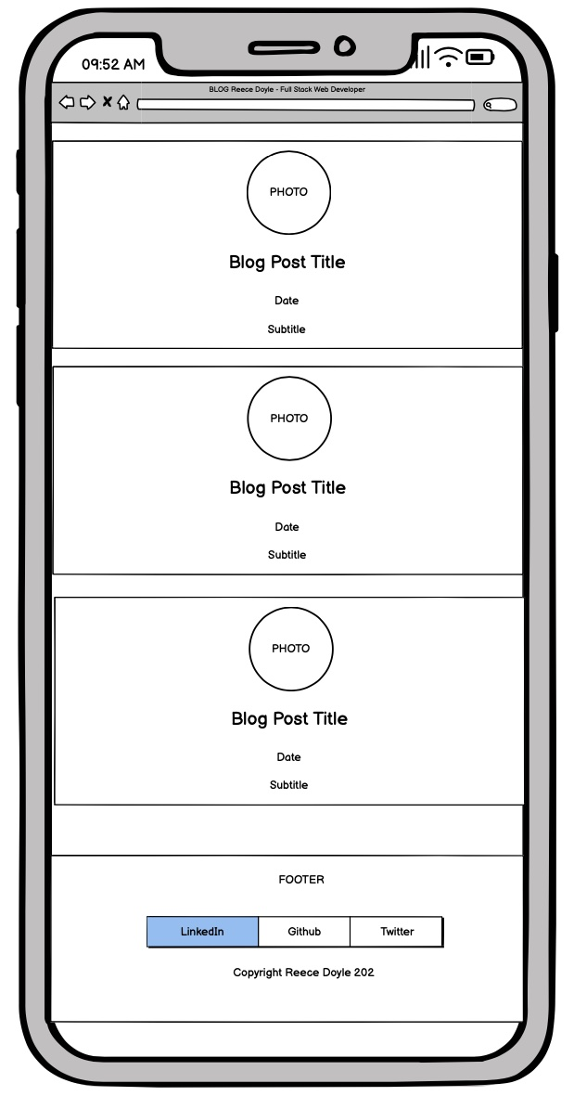

Slide 27
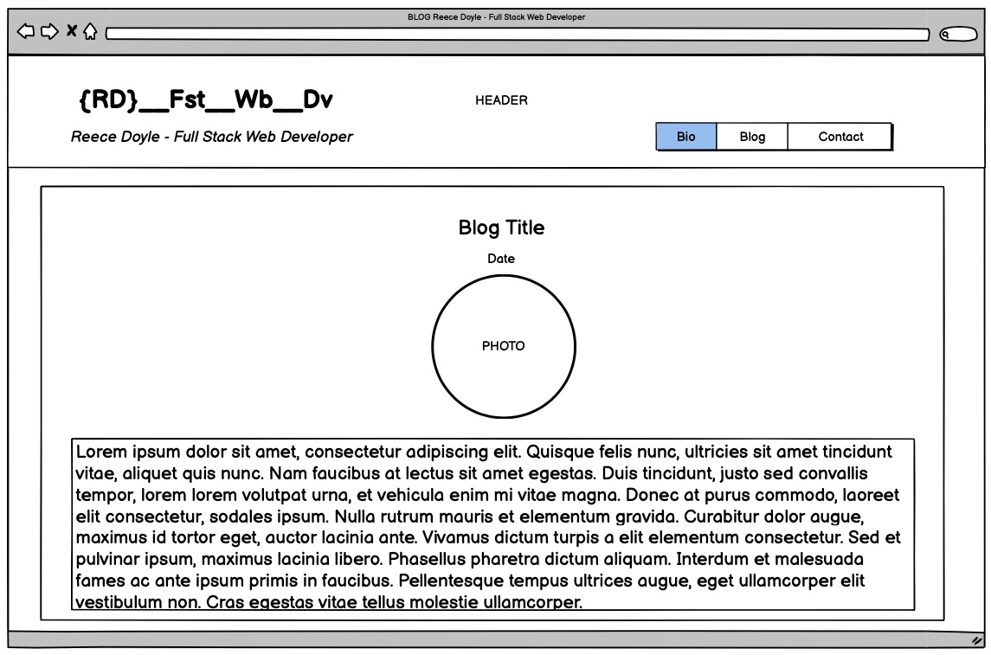
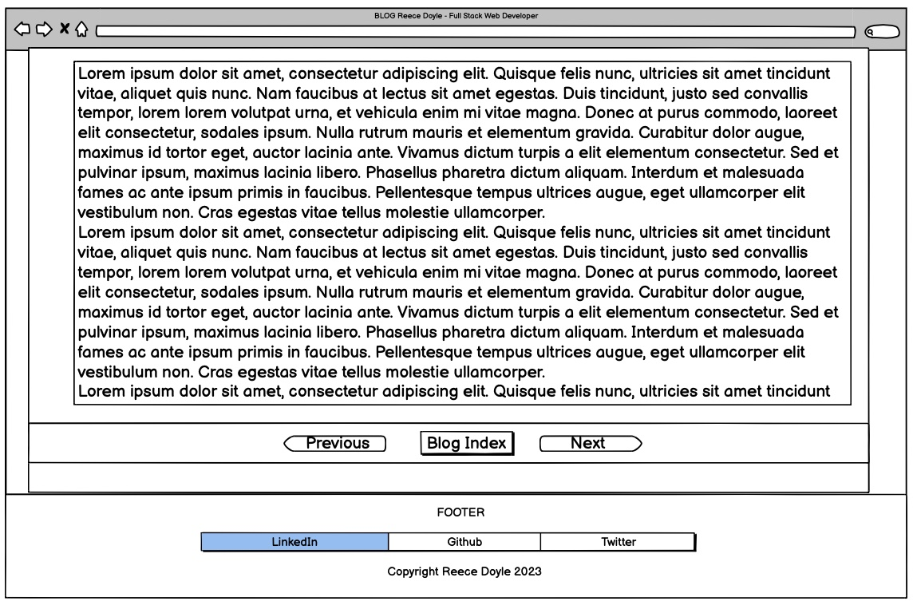

Slide 28
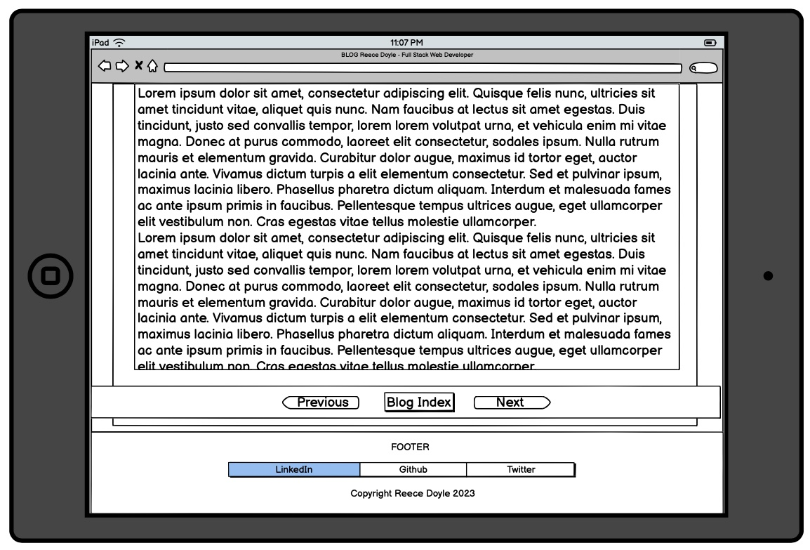
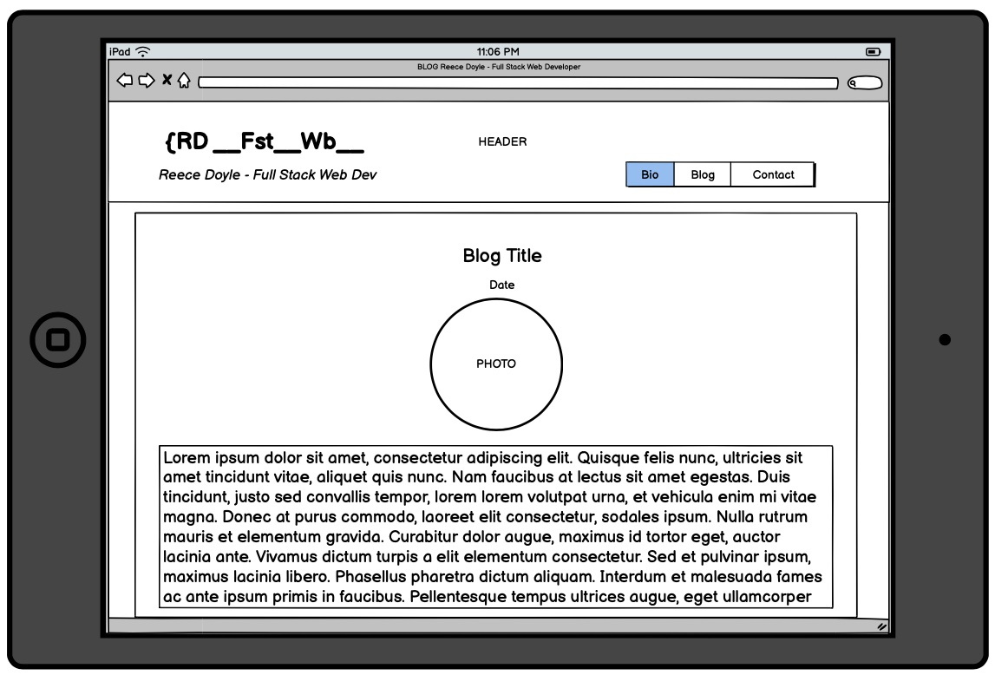

Slide 29
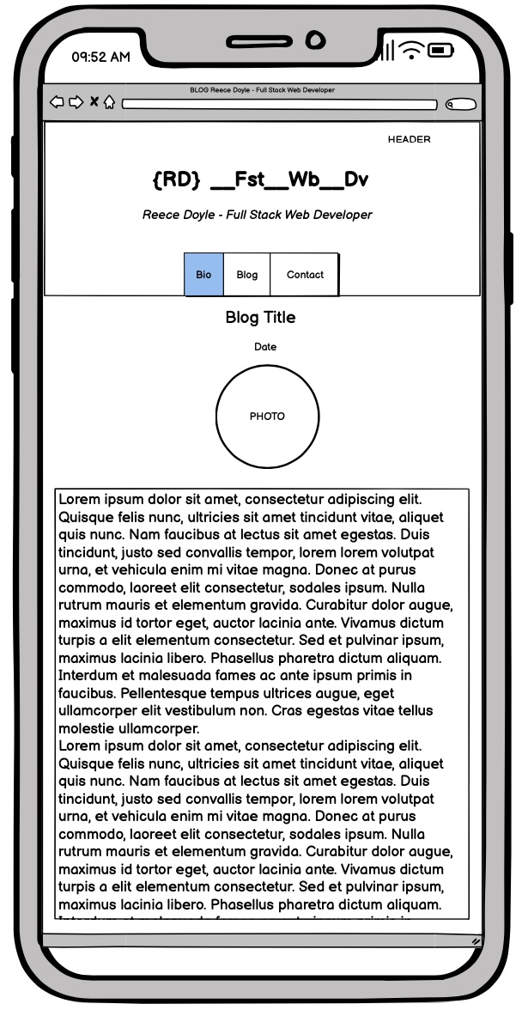
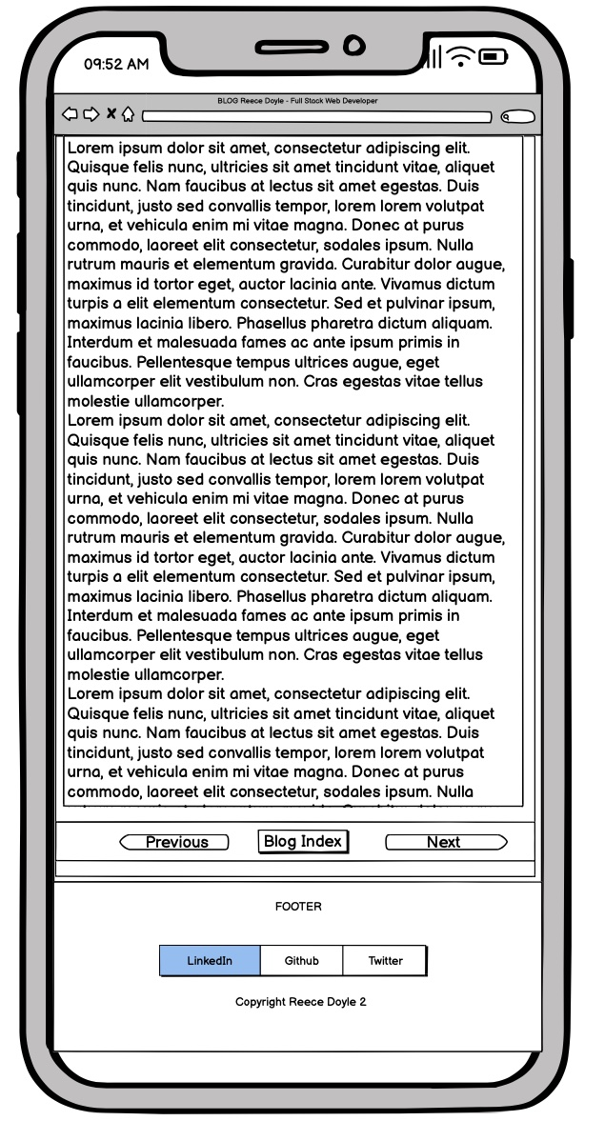

Slide 30
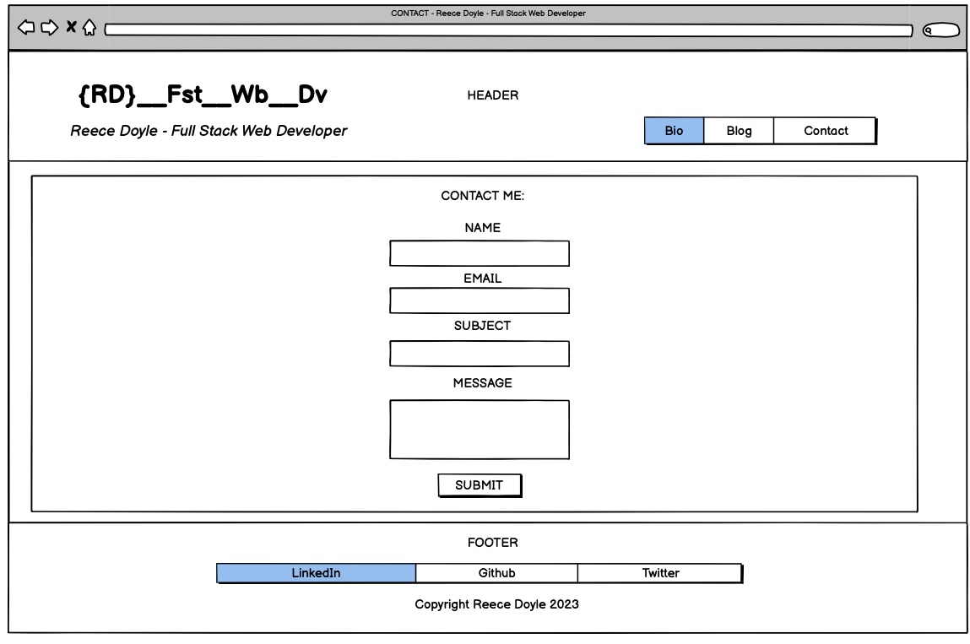

Slide 31
